Slide 1

AI-powered PDF Assistant
Ahmed Badawy

Slide 2

Introduction
Use Case Overview
Business value

Slide 3
Resources
Challenges
AI-powered PDF Assistant With Gemini Pro API
AI-powered PDF Assistant With Qwen2-7B-Instruct

Slide 4
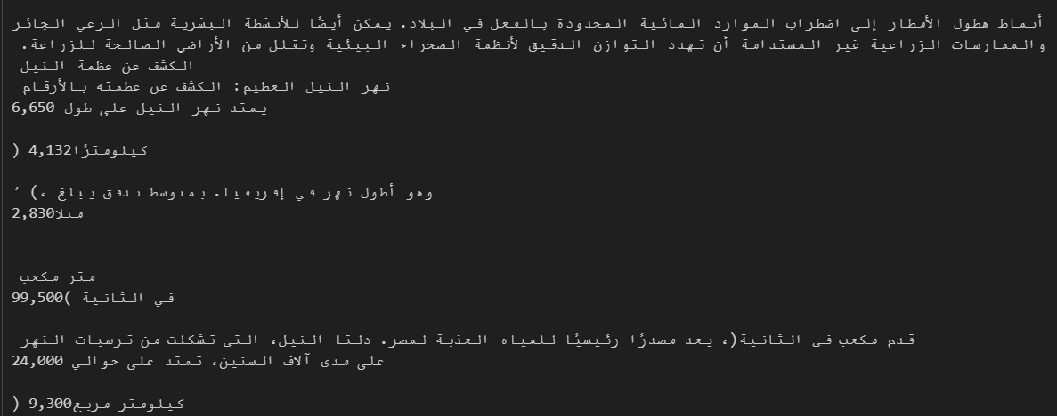
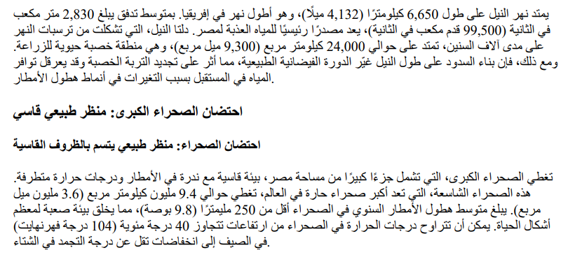
Extract Arabic text from pdf
Challenges

Slide 5
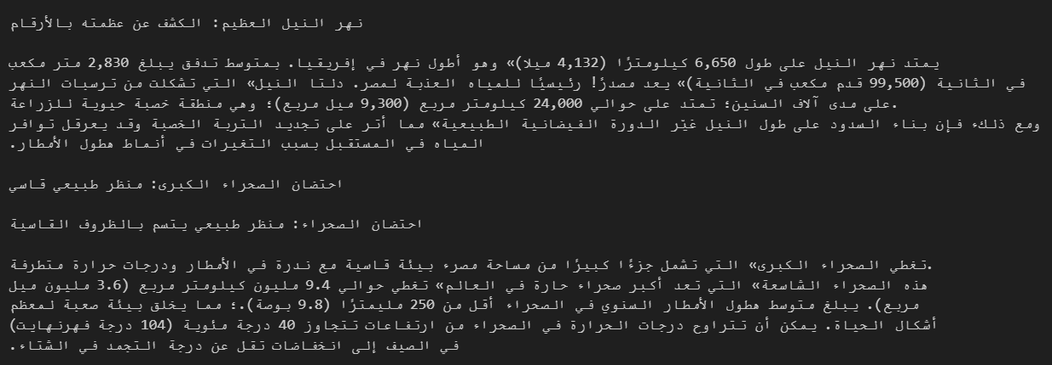
Extract Arabic text from pdf
Challenges
Tesseract

Slide 6
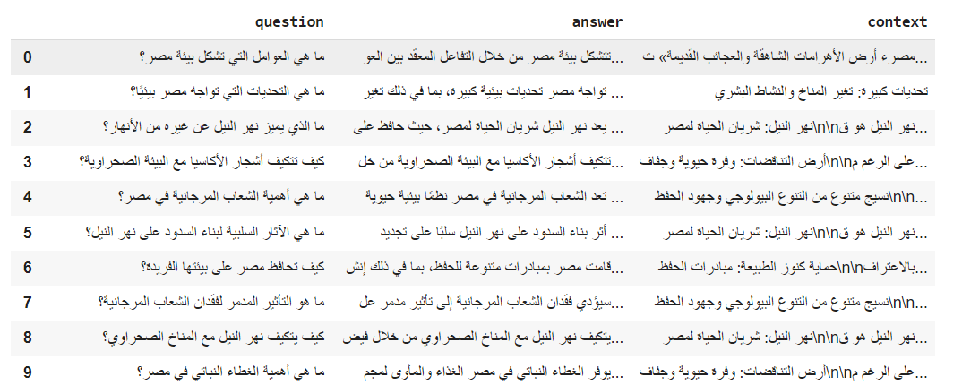
Data preparation
Development
Use the Gemini Pro API to create a dataset for fine-tuning.

Slide 7
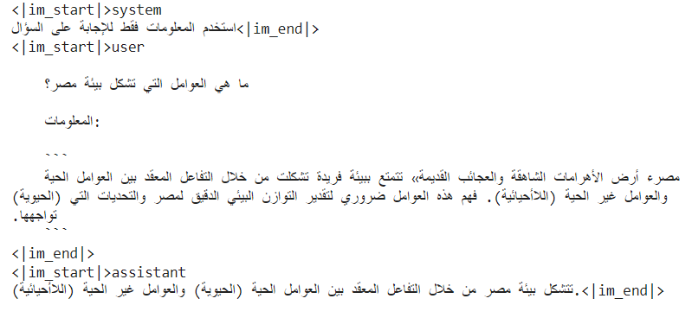
Fine tuning
Development
Fine-tune Qwen2-7B-Instruct.
Quantization
Lora (80 million)
Fine-tuned for two tasks
Question Answering.
Extract KPIs

Slide 8
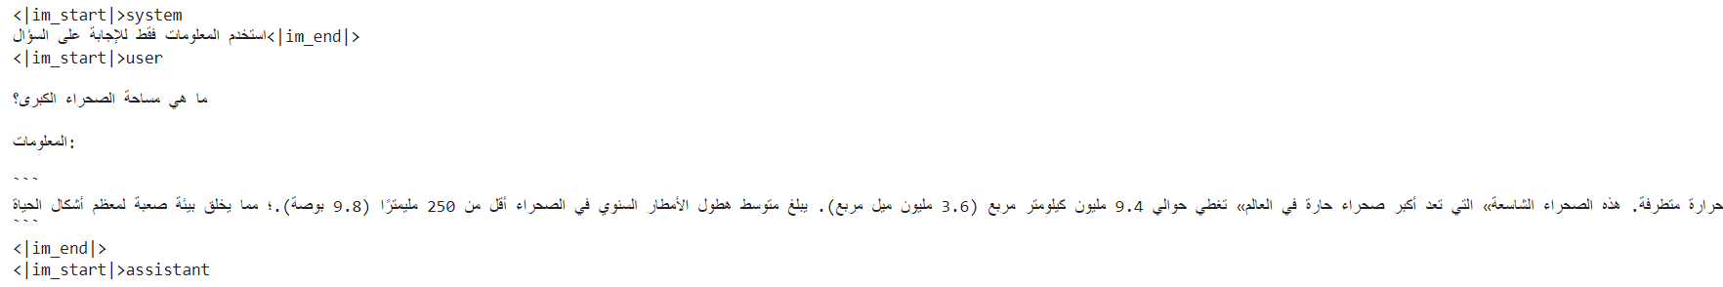
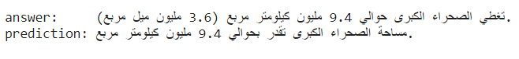
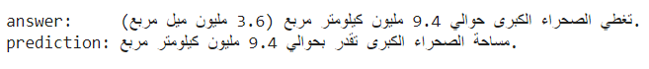
Fine tuning
Development
Test Original Model
Test fine-tuned model

Slide 9
Question Answering

Slide 10
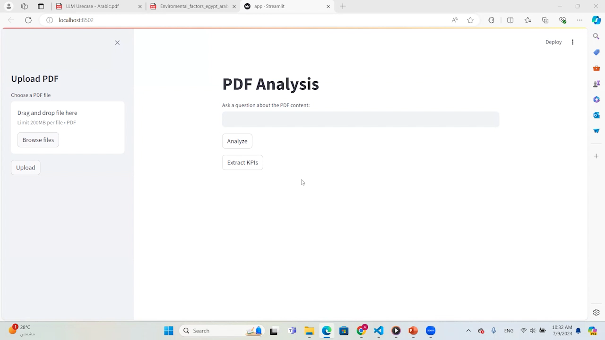
Demo
Streamlit

Slide 11
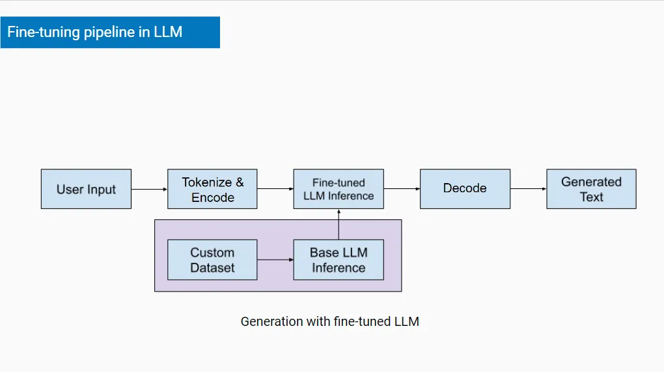
RAG with LLM

Slide 12
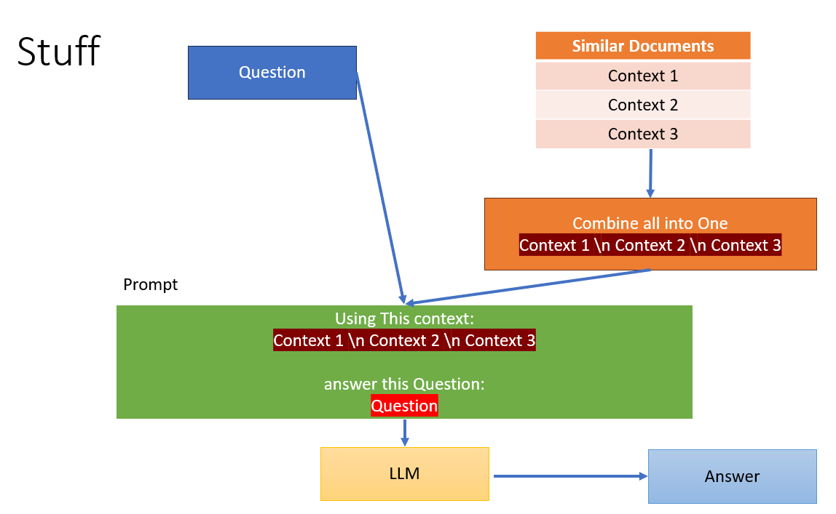
RAG with LLM
Split text into chunks.
Embedding (sentence-transformers/paraphrase-multilingual-MiniLM-L12-v2)
Vectors Stores
Stuff Chain

Slide 13
Dynamic Content Generation

Slide 14
Dynamic Content Generation
Streamlit
Split text into chunks.
Extract KPIs using the Gemini Pro API.
Update KPIs with user values.

Slide 15
Future work
Fine-tune OCR models with Arabic data.
Fine tune LLMs with more Arabic Data.

Slide 16
Thank You

